Slide 1

Clinic Management System
Ms: Eman Fathi

Slide 2
Team Members
Abdelrahman Emam Alaa Abdelbadie Ayman Belal
Sherif Hussien Mayar Ahmed

Slide 3

Welcome!
To Our clinic management system

Slide 4
Agenda
Appointment scheduler
Doctors Management
Patient Management
Medicine Management
Clinic service
Employee Management
Prescription Management
Reports
Permission Management
Invoice Management

Slide 5

Appointment Management

Slide 6


Appointment Features
Create: we can create a new appointment if the chosen time does not already exist
Edit: Appointment can be edit Remove: Appointment can be removed
Appointments can be sorted and filtered
The doctor will be informed of the new appointments
Routes:-
GetAll: can be done by Admin and Employee. Post: can be done by Admin and Employee.
Patch: can be done by Admin and Employee. Delete: can be done by Admin and Employee. GetById: can be done by Admin and Employee.

Slide 7

Doctor Management

Slide 8
Doctor Management
Create: new doctor can be created and checked for the duplicate name.
Edit: doctors' information can be edit
Remove: doctor's information can be removed Doctors can be sorted and filtered
Routes:-
GetAll: can be done by Admin. Post: can be done by Admin.
Patch: can be done by Admin.
Delete: can be done by Admin. GetById: can be done by Admin.

Slide 9
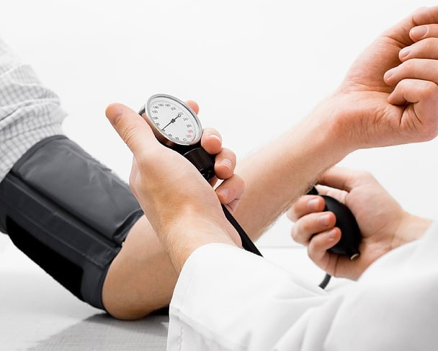
Patient Management

Slide 10
Patient
Create: new patient can be created Edit: patients information can be edit
Remove: patient information can be removed
a patient can be sorted and filtered
Routes:-
GetAll: can be done by Admin and Employee. Post: can be done by Admin and Employee Patch: can be done by Admin and Employee. Delete: can be done by Admin and Employee.
GetById: can be done by Admin and Employee and Doctor.

Slide 11

Medicine Management

Slide 12


Medicine
Create: new medicine can be created Edit: medicine information can be edit
Remove: medicine information can be removed a medicine can be sorted and filtered
Routes:-
GetAll: can be done by Admin and Doctor. Post: can be done by Admin and Doctor Patch: can be done by Admin and Doctor. Delete: can be done by Admin and Doctor.

Slide 13



Clinic
Create: new clinic can be created Edit: clinic information can be edit
Remove: clinic information can be removed a clinic can be sorted and filtered
Routes:-
GetAll: can be done by Admin and Patient. Post: can be done by Admin.
Patch: can be done by Admin. Delete: can be done by Admin.
GetById: can be done by Admin.

Slide 14
Employee
Create: new employee can be created Edit: employee information can be edit
Remove: employee information can be removed An employee can be sorted and filtered
Routes:-
GetAll: can be done by Admin. Post: can be done by Admin.
Patch: can be done by Admin. Delete: can be done by Admin.
GetById: can be done by Admin.

Slide 15
Prescription
Create: new prescription can be created Edit: prescription information can be edit
Remove: prescription information can be removed A prescription can be sorted and filtered
Routes:-
GetAll: can be done by Admin and Doctor. Post: can be done by Admin and Doctor.
Patch: can be done by Admin and Doctor. Delete: can be done by Admin and Doctor.
GetById: can be done by Admin and Doctor.

Slide 16
Reports
reports for invoices reports for appointment
Routes:-
GetAll: can be done by Admin and Employee.
GetById: can be done by Admin and Employee.

Slide 17

Invoices
Create: new invoices can be created Edit: invoices information can be edit
Remove: invoices information can be removed Invoices can be sorted and filtered
Routes:-
GetAll: can be done by Employee. Post: can be done by Employee.
Patch: can be done by Employee. Delete: can be done by Employee.
GetById: can be done by Employee.

Slide 18
Schema

Slide 19
Components
Doctor(ref), Patient( ref),clinic(ref),Date and Time
Appointment
Doctor
fname, lname, Salary, Specialzation, Age Clinic(ref), Email, Password, Image, Gender
Fname,lname,Age,PhoneNumber,Address(City, Street,Building),Email,password,Doctor(ref),A ppointment(ref), Gender, Image
Patient

Slide 20
Components
Name, Type, ExpireDate, ProductionDate, CompanyName, Price
Medicine
Clinic
Name, Department, Address(City, Street, Building), Doctor(ref), PhoneNumber,
Fname, Lname , Age, Gender, Clinic(ref), Email, Password, PhoneNumber, Image, Salary
Employee

Slide 21
Components
Doctor(ref), Patient(ref), Clinic(ref), Date, Medicine (ref)
Prescription
Reports
Invoices (ref All), Appointment (ref All)
Clinic(ref), Medicine (ref), Patient (ref), Doctor(ref), Employee(ref), Date, EmployeeName ,Payment Method
Invoices

Slide 22
Components
Fname, lname, Age, PhoneNumber, Gender, Email, Password, Role, Salary, Address, Specialty, Vezeeta, ClinicId
Permission

Slide 23
Package and API
Stripe API ----> Payment multer ----> Image mongoose sequence bcrypt
devenv dotenv jsonwebtoken morgan nodemon mongoose express
express-validator

Slide 24
Thank you

